Slide 1
Banking App
-Prathmesh Patil

Slide 2
Introduction
At the past, the only way to keep a user's information safe in a bank was to input and record it. Every time the user wants to conduct a transaction, he or she must travel to the bank and go through the necessary formalities, which may or may not be feasible. For both consumers and lenders, it may be a challenging process. The project provides a practical grasp of the banking system and the actions carried out by various supply chain roles.

Slide 3
Features
User credentials are saved in the database.
Whenever user wants to login would not go for registration process again.
User can view other user profiles.
User can do transaction with other users.
Every transaction records are maintain.

Slide 4
Requirements
Software :-
Programing language :- Java
Database :- SQLite database
Tool :- Android Studio
Hardware:-
64-Bit Microsoft Windows 10 Pro
Intel(R) Core(TM) i3-9100F CPU @ 3.60GHz, 3600 Mhz, 4 Core(s), 4 Logical Processor(s)
Physical Memory (RAM) 8.00 GB

Slide 5
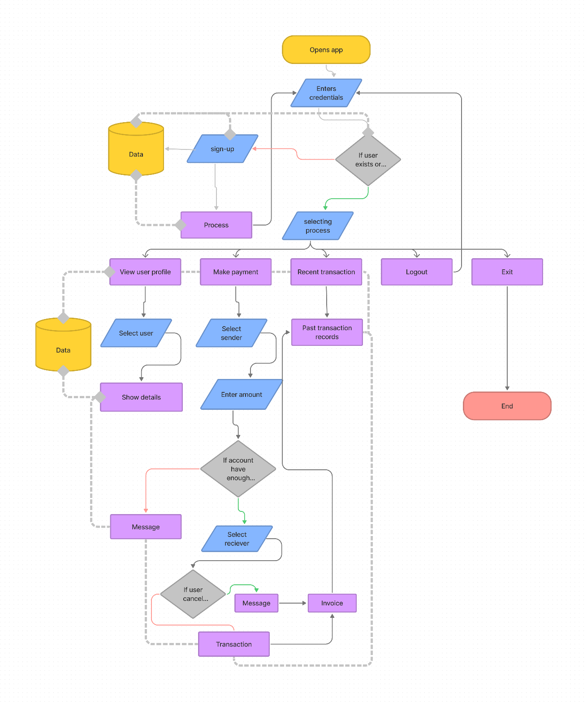
Implementation
Activity diagram of the Banking app.

Slide 6


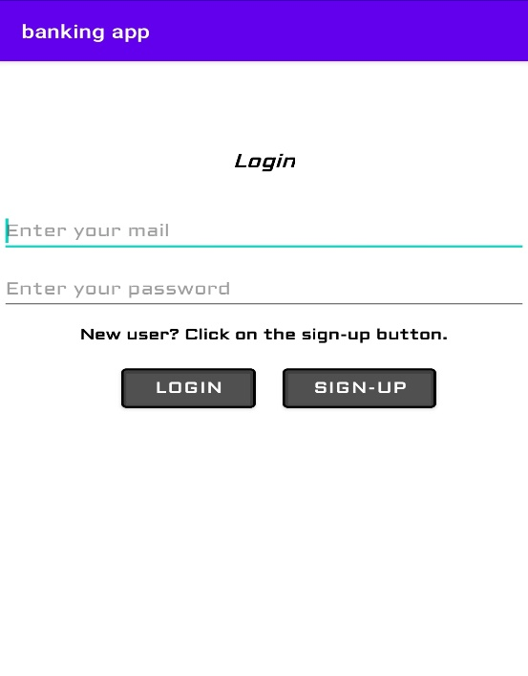
This is the login screen.

Slide 7
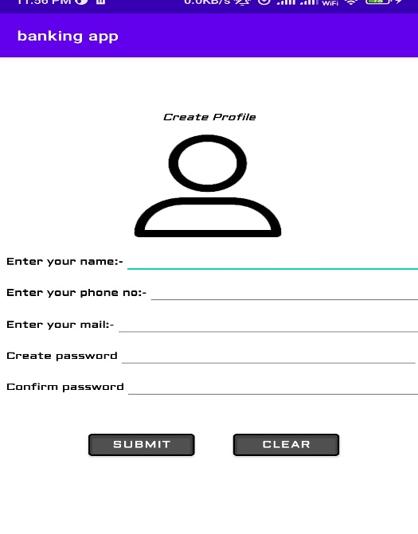
This is the register screen, if user didn’t he or she has to register.

Slide 8
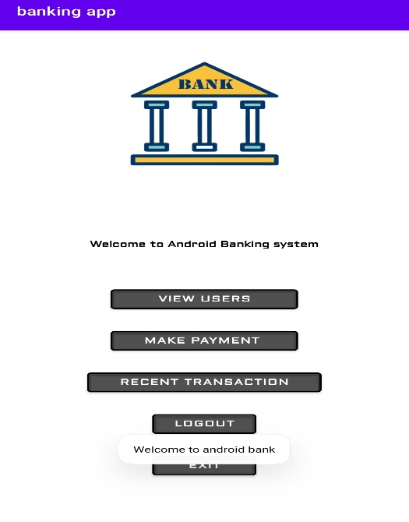
This is the home screen where user will interact.

Slide 9
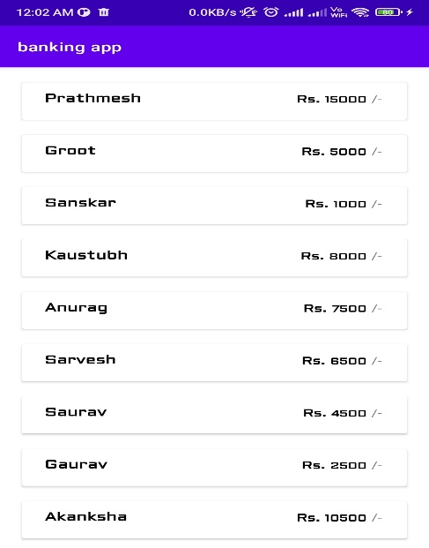
This the view user screen where user can see the other users.

Slide 10
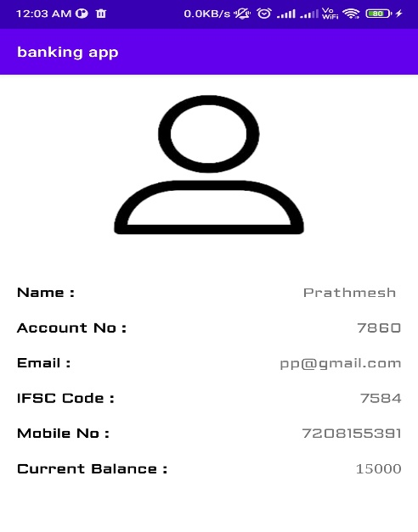
User details screen where user can see the details of other user.

Slide 11
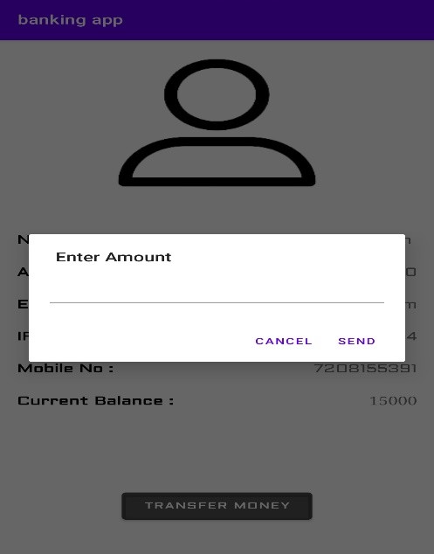
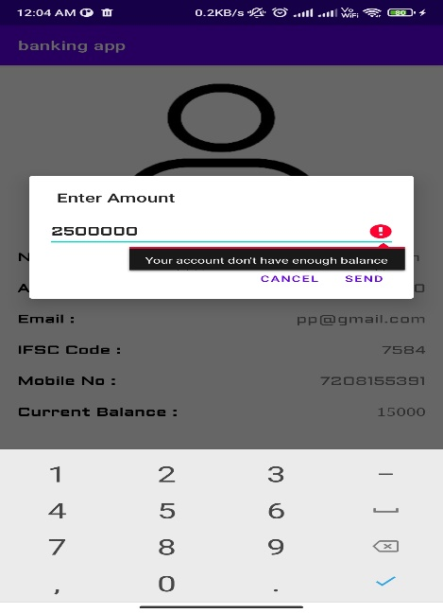
This is the payment screen where user have to enter a amount to be send to other if user enters amount which is more than the amount balanced in his/her account. The user will get this error message.

Slide 12
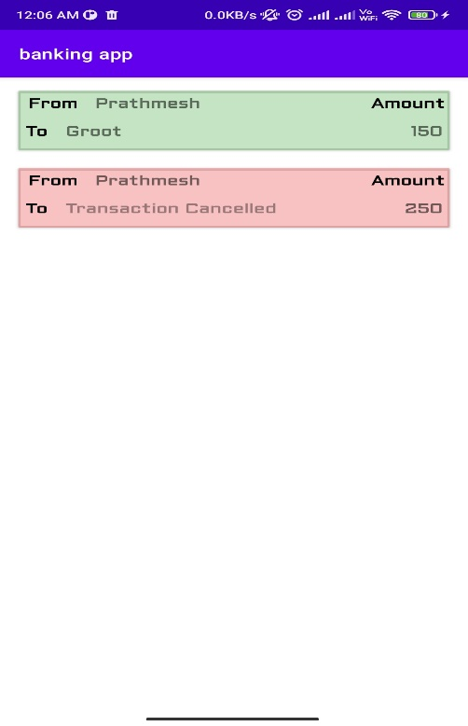
This is the transaction screen where user will get record of each transactions which is either successful or failed.

